Slide 1

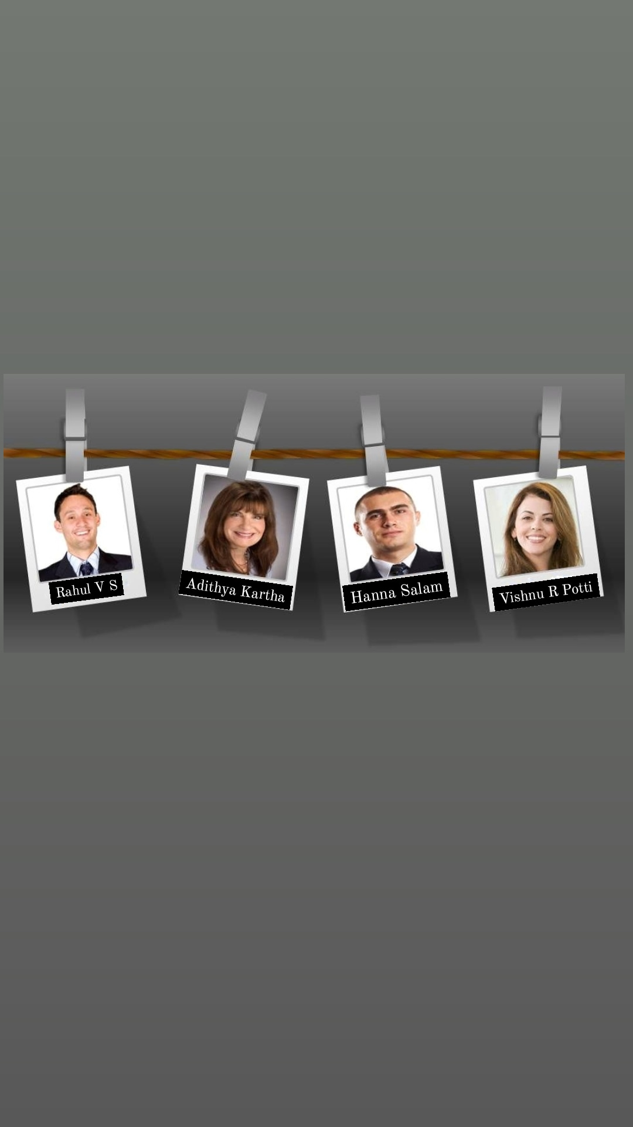

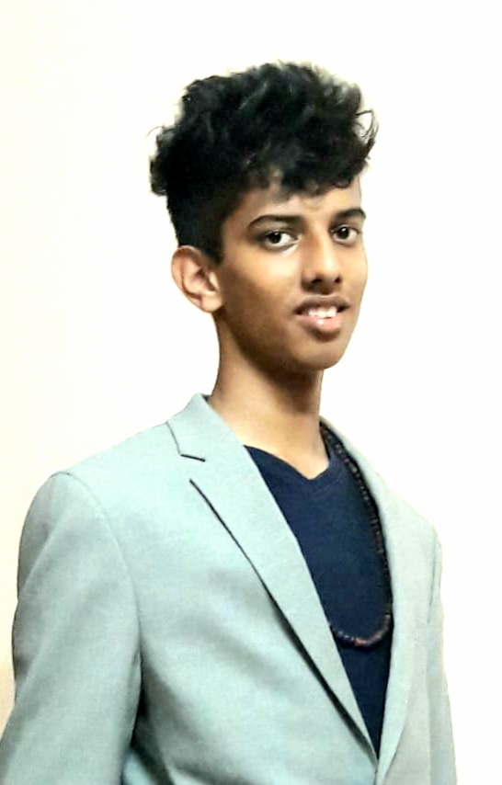
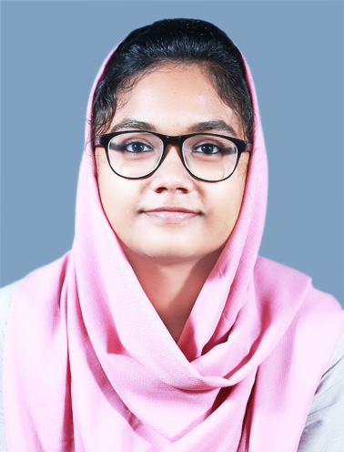

CSB
FIRST YEAR
MEC
CSA
FIRST YEAR
MEC
CSB
FIRST YEAR
MEC
CSB
FIRST YEAR
MEC

Slide 2
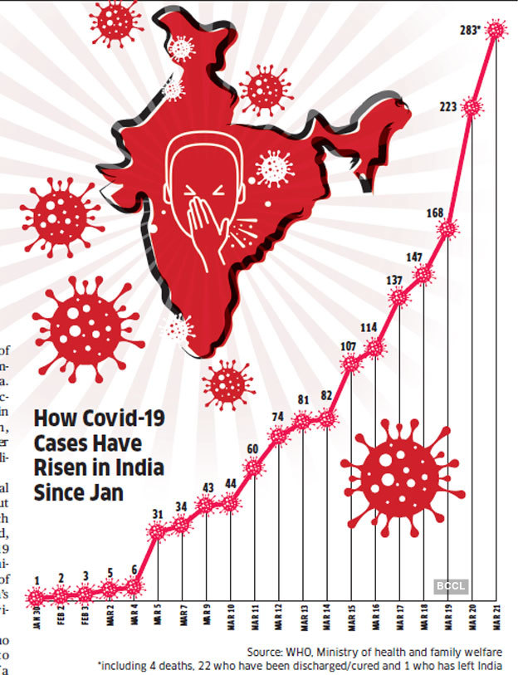
TOPIC: PERSONAL MEDICAL ASSISTANT
SISTANT
PROBLEM:
Due to the current pandemic situation, the whole world is scared to go out to hospital for their regular checkups and seek medical help for the common disease like cold, cough etc...
So for a cure they use the online apps and webpages.
But checking these without knowing what the actual disease is, can be harmful because every allopathic medicine comes with side effects.

Slide 3
"Nature itself is the best physician"- Hyppocrates "The healing comes from nature and not from the physician. Therefore the physician must start from nature with an open mind" - Paracelsus
SOLUTION:
So we have found out the best way to tackle this situation.
“Home remedies".
Home remedies was the root of treatment for centuries.
So why don’t we use them now?

Slide 4
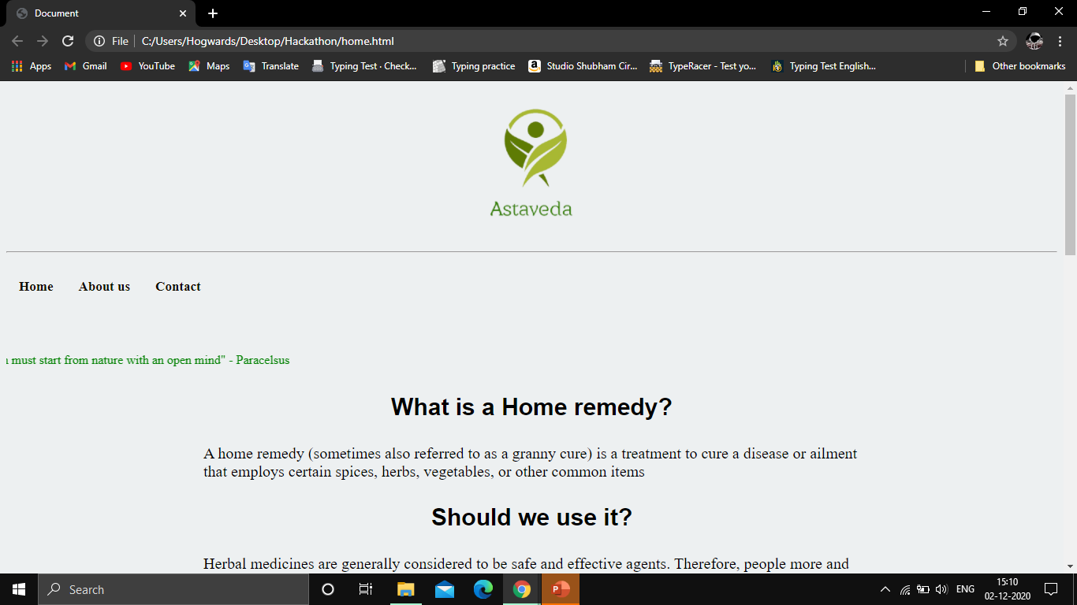
So we have build a website that shows some common home remedies
*GITHUB REPO GIVEN

Slide 5
We don’t plan in stopping here……
Future add-ons planned:
Chatbot for personalized experience. It should also be able to recognize plants and herbs from pictures so that the new generation users who do not have much knowledge in this area can be helped.
Adding yoga asanas which can be used for prevention and reduction of diseases

Slide 6
THANK YOU…..

